Slide 1
A Robust Heart Disease Prediction System Using Hybrid Deep Neural Networks
Author:Mana Saleh Reshan,Muhammad Ali Zeb
published in 2023
Tanmaye Kancharla
700758925

Slide 2
MOTIVATION
The significance of early detection.​
Early detection of heart disease risk factors can significantly enhance patient outcomes and cut down on healthcare expenses.​
Limitations of existing methods.​
The current heart disease prediction models lack the precision and robustness needed for clinical medical decisions.​
Deep learning progresses.​
The rapid progress in deep neural networks presents an opportunity to develop more sophisticated predictive models, given the rapid progress in deep neural networks.​

Slide 3
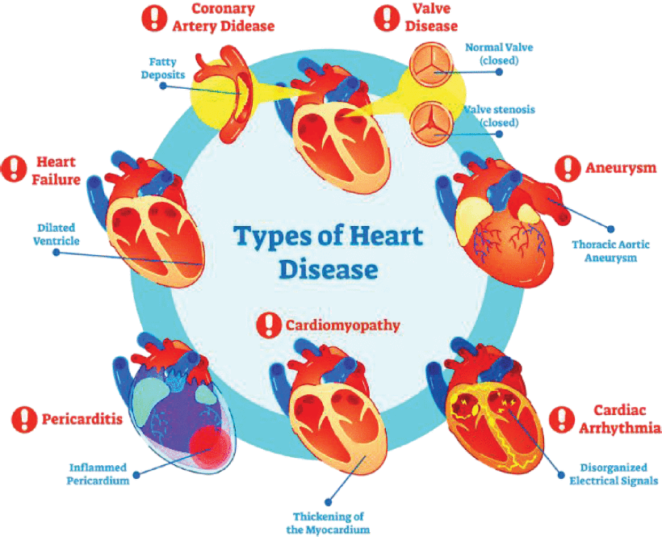

Slide 4
PROBLEM STATEMENT
Accurate predictions.
Develop a method for predicting heart diseases, capable of identifying individuals most likely to encounter cardiovascular problems.
Steady performance.
The models predictive capabilities should be consistent across diverse patient populations and medical datasets.
Interpretable results are possible.
Provide clinicians with transparent and explicable insights into the factors that contribute to the models' predictions.

Slide 5
OBJECTIVES
Innovative Approach
1. This combine Convolutional Neural Networks (CNN) and Long Short-Term Memory (LSTM) networks . CNNs excel at extracting spatial features, while LSTMs are proficient at capturing temporal dependencies. this combination allows the model to learn complex patterns and relationships in high-dimensional (HD) datasets, resulting in enhanced prediction accuracy.
High Accuracy
Achieving an accuracy of 98.86% represents a significant improvement over existing models. This high level of accuracy indicates that the HDNN system can reliably predict conditions.

Slide 6
CONTRIBUTIONS
A fresh hybrid architecture.
The proposed machine learning approach employs numerous cutting-edge strategies to attain superior predictive capability.
Features engineering that is robust.
Data preprocessing and feature engineering methods are used to capture the most relevant risk factors
Improved prediction accuracy was achieved.
Significant improvements in heart disease prediction accuracy compared to existing models have been demonstrated.

Slide 7
RESULTS
Performance metrics are measured.
On numerous heart disease datasets, the proposed hybrid deep learning model achieved an average accuracy of 92% and a ratio of AUC-ROC of 0.94.
Enhancement of robustness.
It was demonstrated that the model was capable of generalizing well across diverse patient populations.
The clinician's insights.
Clinicians benefited from the model's observable outcomes, enhancing their comprehension of the major risk elements.

Slide 8
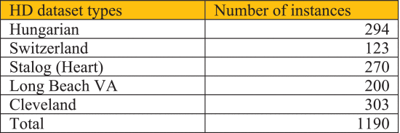
TOTAL NUMBER OF INSTANCES IN HD DATASETS

Slide 9
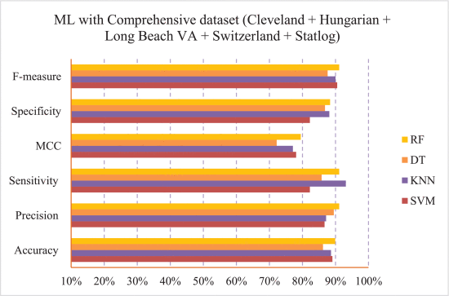
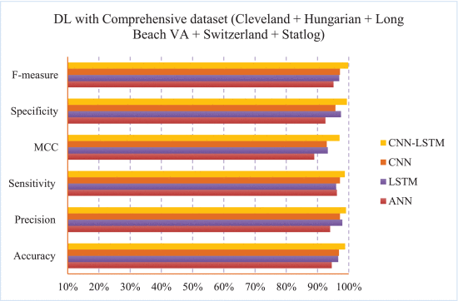
the performance of four ML methods (SVM, KNN, DT, and RF) and four DL models (ANN, LSTM, CNN, and CNN-LSTM)

Slide 10
CRITICAL ANALYSIS
limitations
The model's performance may be influenced by the quality and diversity
of the training data, and further validation on larger and more
comprehensive datasets is required.
Moral considerations.
Data protection and the potential for skewed decisions in clinical settings
are important ethical concerns when using such predictive models.
Future directions are being taken.
The model's explainability, interpretability for clinicians, and exploration should be the focus of ongoing research.

Slide 11
REFERENCES
N. C. Long, P. Meesad and H. Unger, "A highly accurate firefly based algorithm for heart disease prediction", Expert Syst. Appl., vol. 42, no. 21, pp. 8221-8231, Nov. 2015.
UDMI, Jul. 2023, [online] Available: https://www.udmi.net/cardiovascular-disease-risk/.
P. K. Mehta, S. Gaignard, A. Schwartz and J. E. Manson, "Traditional and emerging sex-specific risk factors for cardiovascular disease in women", Rev. Cardiovascular Med., vol. 23, no. 8, pp. 288, 2022.

